Slide 1
Linear Algebra
Lecture 23

Slide 2
Vector Spaces

Slide 3
Coordinate
Systems

Slide 4

Theorem
  Let B = { b₁, … , b_{n} } be a
  basis for a vector space V.
  Then for each x in V, there
  exists a unique set of scalars
  c₁, … , c_{n} such that

Slide 5

Definition
Suppose the set B = {b₁, …, b_{n}} is a basis for V and x is in V. The coordinates of x relative to the basis B (or the B-coordinates of x) are the weights c₁, … , c_{n} such that

Slide 6
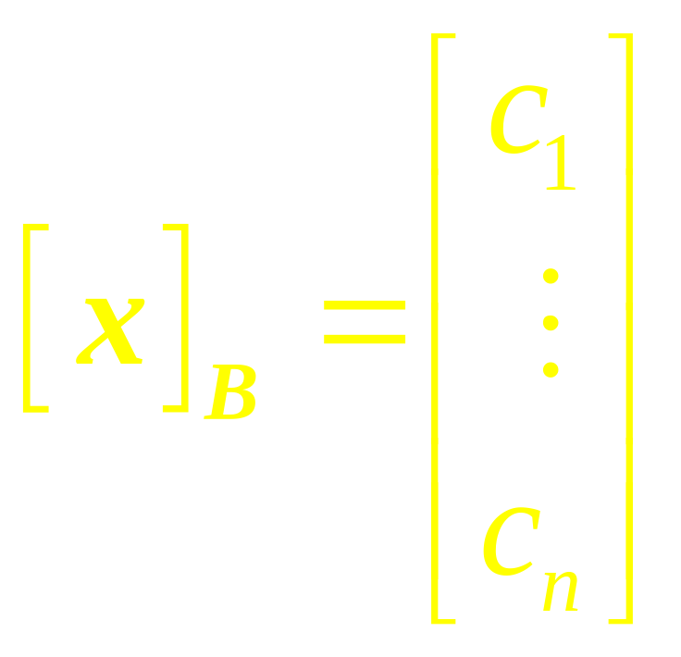
If c₁,c₂,…,c_{n} are the B-Coordinates of x, then the vector in R^{n}
is the coordinate of x (relative to B) or the B-coordinate vector of x. The mapping x → [x]_{B} is the coordinate mapping (determined by B)

Slide 7
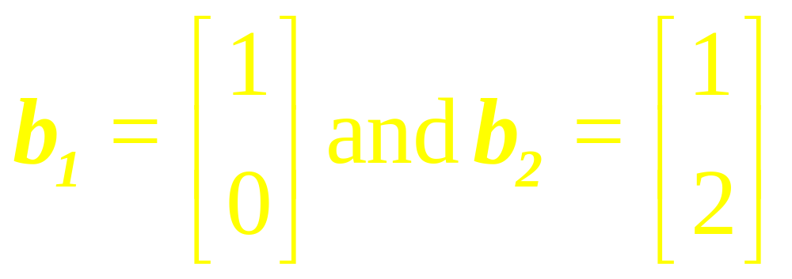
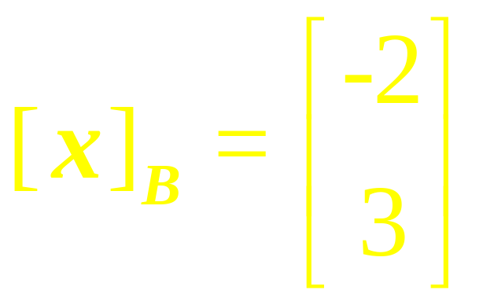
Suppose an x in R² has the coordinate vector
Example 1
Consider a basis B = {b₁, b₂}
for R², where
Find x.

Slide 8
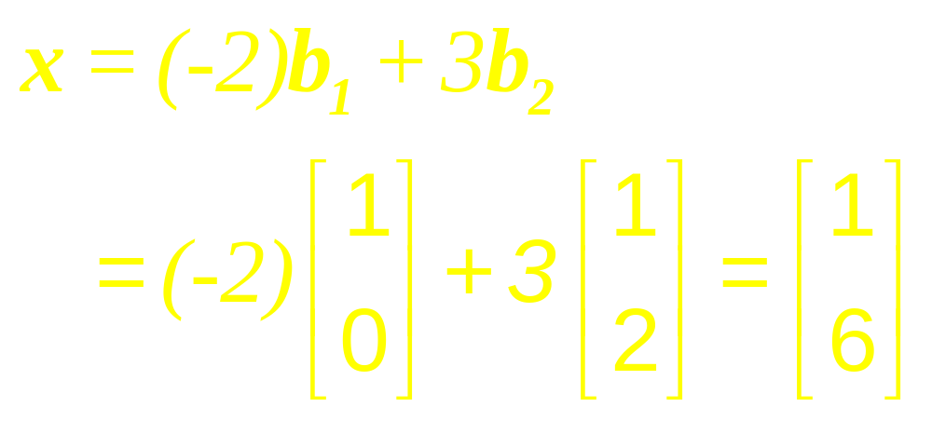
Solution

Slide 9
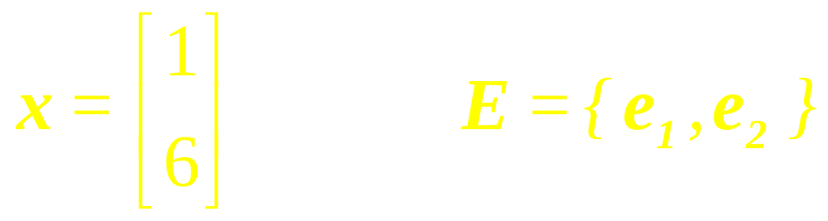
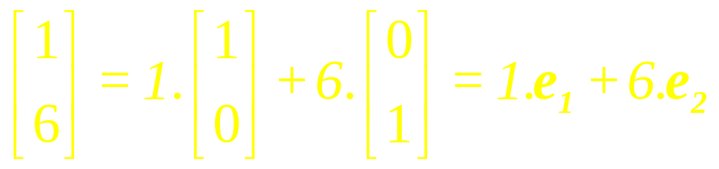

Example 2

Slide 10
Example 3
Let S = {v₁, v₂, v₃} be the basis for R³, where
v₁ =(1, 2, 1),
v₂ = (2, 9, 0),
v₃ = (3, 3, 4).
…

Slide 11
(a) Find the coordinates vector of v = (5, -1, 9) with respect to S.
(b) Find the vector v in R³
whose coordinate vector
with respect to the basis S
is [v]_{s} = (-1, 3, 2)

Slide 12
Example 4
Find the coordinates vector of the polynomial
p = a₀ + a₁x + a₂x₂
relative to the basis
S = {1, x, x²}
for p₂.

Slide 13
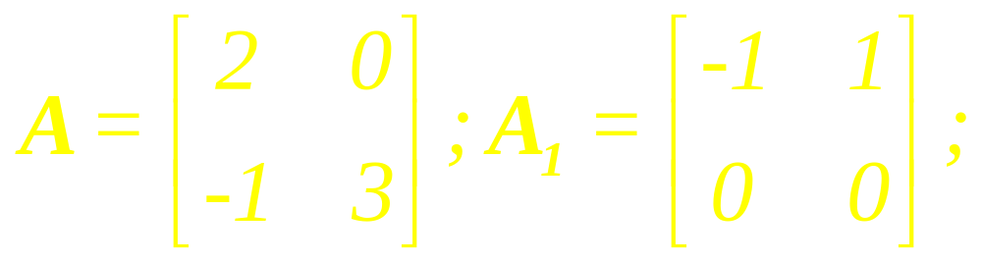
Example 5
Find the coordinate vector of A relative to the basis
S = {A₁, A₂, A₃, A₄}, where

Slide 14
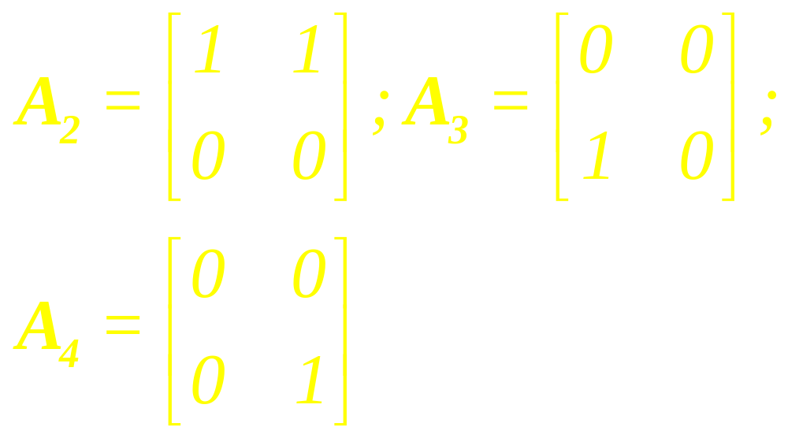

Slide 15
A Graphical
Interpretation
of Coordinates

Slide 16
Example 6

Slide 17
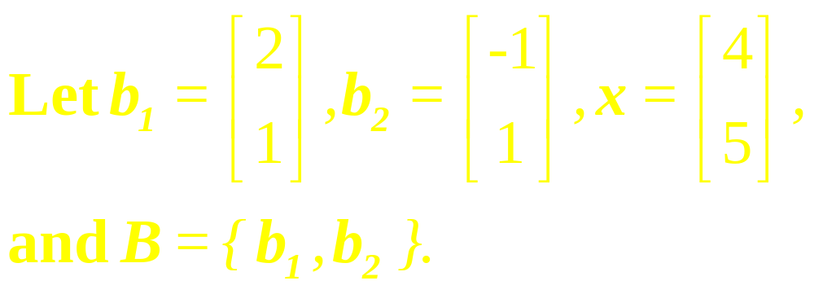
Example 7
Find the coordinate vector [x]_{B} of x relative to B.

Slide 18

Theorem
Let B = {b₁, … , b_{n}} be a basis for a vector space V. Then the coordinate mapping
is a one-to-one linear transformation from V onto R^{n}

Slide 19
Examples

Slide 20
Linear Algebra
Lecture 23

